Slide 1
Thailand presentation
Session 18 :
Country strategies for improving
civil registration and vital statistics systems
in the region
Workshop on the Operation of Civil Registration, Vital Statistics and Identity Management Systems for East Asian Countries
@ United Nation House, Hanoi, Vietnam

Slide 2
Outline
analysing national arrangements and practices
strategies to improve the coverage and accuracy of CRVS systems

Slide 3
analyzing country setting
maahalai.com

Slide 4
analyzing country setting
1. Analyze core topics collected in our country
2. Analyze national institutional arrangements
3. Identify SDG indicators (direct) relevant for CRVS

Slide 5
9.1. Analyze core topics collected : forms involved are
Birth registration form
Death registration form
Marriage registration form
Divorce registration form

Slide 6
Birth 1
(i) Characteristic of the event
Date of occurrence (1)
Date of registration (2)
Place of occurrence (3)
Place of registration (3)
Attendant at birth (38)

Slide 7
Birth 2
(ii) Characteristics of the newborn
Sex (12)
Weight at birth (14)
Age (11) – not core

Slide 8
Birth 3
(iii) Characteristics of the mother
Place of usual residence (6)
Place or country of birth (9)
(iv) Characteristics of the father
Place of usual residence (6)
Age (11) – not core

Slide 9
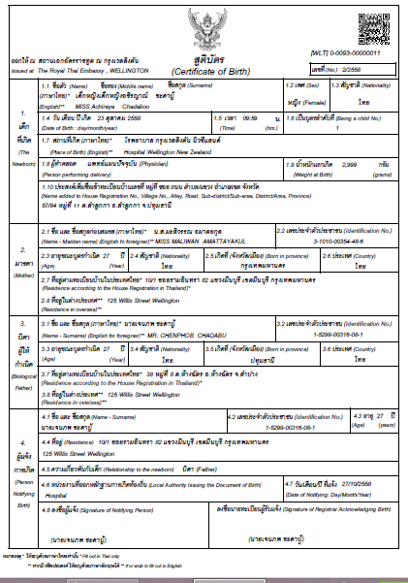

Slide 10
death
(i) Characteristic of the event
Date of occurrence (1)
Date of registration (2)
Place of occurrence (3)
Place of registration (3)
Cause of death (41)
Sex (12)
Marital status (27)
Place of usual residence (6)
Age (11) –not core

Slide 11
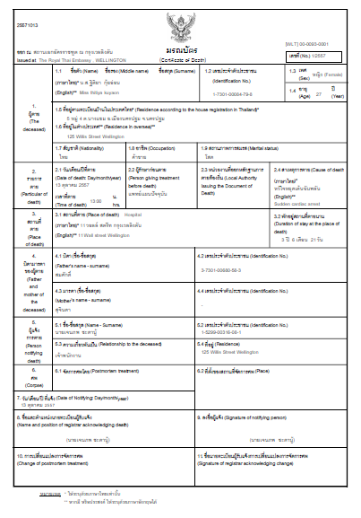

Slide 12
marriage
(i) Characteristics of the event
Date of registration (2)
Place of registration (3)
(ii) Characteristics of bride and groom (separately)
Date of birth (11)

Slide 13
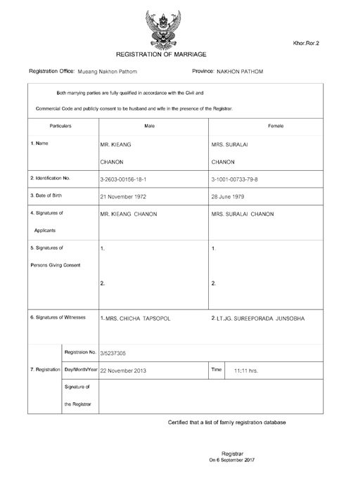

Slide 14
divorce
(i) Characteristics of the event
Date of registration (2)
Place of occurrence (3)
(ii) Characteristics of divorces
(husband and wife separately)
Date of birth (11)
Date of marriage (26)

Slide 15
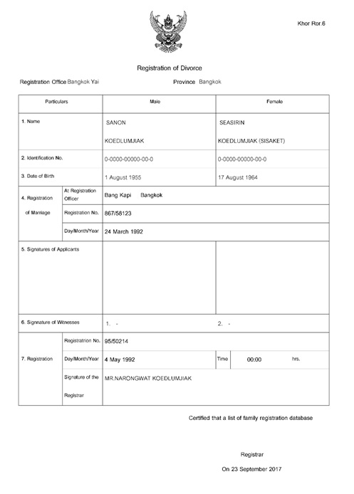

Slide 16
2. Analyze national institutional arrangements
Thailand has centralized system structure
Separate agencies for CRVS
• Health Statistics Division of Ministry of Public Health compiles VS
• Civil Registration Division of Department of Local Administration, under Ministry of the Interior, manages CR
• Central Registration Division authority office is located in the capital city, Bangkok; it supervises registration offices throughout the country
• Vital events may be reported to local registrars at the municipal and district level; “Tambon” registrars at the subdistrict level; and assistant Tambon registrars at the village level

Slide 17
3.Identify SDG indicators (direct)
relevant for CRVS
Goal 3. Ensure healthy lives and promote well-being for all
at all ages
Goal 16: Promote peaceful and inclusive societies for sustainable development, provide access to justice for all
and build effective, accountable and inclusive institutions
at all levels
Goal 17: Revitalize the global partnership for sustainable development
maahalai.com

Slide 18
3.Identify SDG indicators (direct)
relevant for CRVS (1)
Goal 3. Ensure healthy lives and promote well-being for all at all ages
indicator
3.1.1 Maternal mortality ratio
3.2.1 Under-five mortality rate
3.2.2 Neonatal mortality rate
maahalai.com

Slide 19
3.Identify SDG indicators (direct)
relevant for CRVS (2)
Goal 16: Promote peaceful and inclusive societies for sustainable development, provide access to justice for all and build effective, accountable and inclusive institutions at all levels
Indicator
16.9.1 Proportion of children under 5 years of age whose births have been registered with a civil authority, by age
maahalai.com

Slide 20
3.Identify SDG indicators (direct)
relevant for CRVS (3)
Goal 17: Revitalize the global partnership for sustainable development
indicator
17.19.2: Proportion of countries that (a) have conducted at least one population and housing census in the last 10 years; and (b) have achieved 100 percent birth registration and 80 percent death registration
maahalai.com

Slide 21
strategies to improve CRVS systems
maahalai.com

Slide 22
strategies to improve CRVS systems
The main obstacles for achieving complete coverage of vital events registration
The main obstacles for improving accuracy of registered information
The main obstacles for compiling vital statistics based on civil
registration data as the main source.
Efforts carried out for assessing the quality of their CRVS systems
Measures taken to improve quality and interoperability of CRVS
maahalai.com

Slide 23
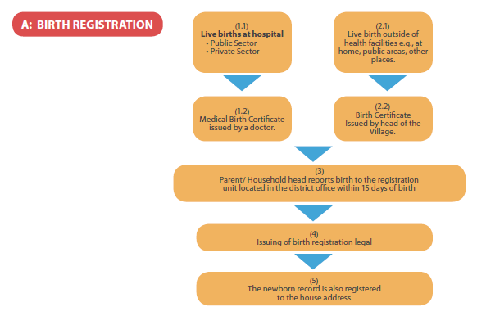
Processes of birth registration in Thailand

Slide 24
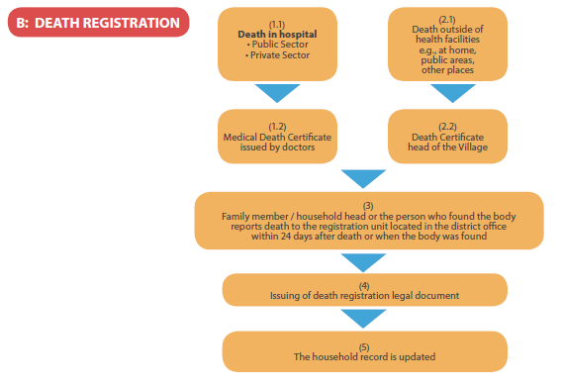
Processes of death registration in Thailand
Within 24 hours

Slide 25
Topics (1)
The main obstacles for achieving complete coverage of vital events registration
Our citizen are misunderstood between birth notification and birth certification
Tiny amount of information of birth event at border line is lost.
The main obstacles for improving accuracy of registered information
Human error when input data
for example
order of twins data is not correct
birth date is not correct because officer key the information late
Network error
maahalai.com

Slide 26
Topics (2)
The main obstacles for compiling vital statistics based on civil
registration data as the main source.
Accuracy of cause of death data
Non-hospital death: relatives provide general symptoms or senility as the causes of death
  In-hospital death: doctors use mode of death instead of the causes
maahalai.com

Slide 27
Topics (3)
Efforts carried out for assessing the quality of our CRVS systems
Thai health information standard development center had done rapid assessment of national civil registration and vital statistics systems
The stakeholders discussed and scored all 25 questions in 11 main areas.
The total score was 84.
The average scores of “practices affecting the quality of cause of death data” was the lowest.
maahalai.com

Slide 28
Topics (4)
Measures taken to improve quality and interoperability of CRVS
MOPH signed an agreement with MOI, regarding utilization of vital registration data from the central registration database of the administration (expected to reduce redundancy)
Training on cause of death for health care professionals and registrars or related officers to increase the reliability of cause of death data in 77 provinces.
Change system of the person who give cause of death outside hospital from head village to local or district registrars
maahalai.com

Slide 29
Conclusions
CRVS systems in Thailand is computerized with a high coverage of registration
Room for improvement
Especially, coding of causes of deaths

Slide 30
Ongoing strategies (1)
Providing a systematic of coordinated of mechanism by establishing the committee integrating between relevance agencies.
Training persons who responsible for input cause of death data that occurring outside hospital to improve their potential and improve qualities of the data

Slide 31
Ongoing strategies (2)
Review the quality assessment to promote the quality and reliability of CRVS data
Determining the training course on Case of death for the responsible person
Utilize IT in improving cause of death system
Encourage the use of CRVS data

Slide 32
linkage of
Registration Database system in Thailand

Slide 33




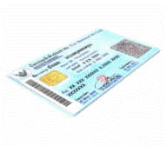
The Revenue Department
Service
Service
Service
Consular Department
GIN
GIN
GIN
Royal Thai Police
Service
Service
Department of Agriculture
GIN
Service
GIN
Central population database center
Service
Service
Social Security Office
GIN
Service
Service
GIN
Bank
Service
GIN
NHSO
Authentication and Access Control
Service
145th organization
citizen
Government officer

Slide 34
Thank you for your attention

Slide 35
• Must be registered within 15 days
• The household head or the baby’s mother are responsible for reporting
• Required documents for birth registration are the ID card of either the mother or father and a copy of the household booklet.
The household booklet is then updated with details of the baby.
• Two types of birth are defined: hospital birth, and out-hospital birth. The birth document is issued by the hospital or the head of the village.
• Births outside of the country can be reported through the Thai embassy in that country.
• The personal identification number is assigned by the District Registrar at the time of registration of birth, or whenever the individual enters into the population register for the first time.
Vital Event Regulation practices in Thailand
Birth

Slide 36
• Must be registered within 24 hours.
• Two types of death certificates: one for deaths that occur in hospital, and another for deaths outside of hospital. The former case uses standard form of the WHO , and the latter uses the official form of the MOI .
• The head of the household or the person who finds the body must report the event.
• Required documents for the death report are the ID card of the reporter, the ID card of the dead person (optional), a death certificate from either the hospital or the head of the village, and a copy of household booklet of the dead person (optional). The household booklet of the dead person is then updated.
• Locations to report deaths or still births are the same as for birth registration.
Vital Event Regulation practices in Thailand
Death

